Slide 1
Telling stories with charts – Mastering ggplot2

Slide 2
Reminder from the previous unit
We talked about RStudio and got to know the environment
We cloned the repository, opened a new project, opened a new markdown
Understood the difference between scripts and RMarkdown
We learned the base-r syntax, including loops, and functions
We created an example function which computes the Fibonnacci series, and we did that in two methods: recursion and a loop
We talked about debugging
Today we will be discussing visualizations

Slide 3
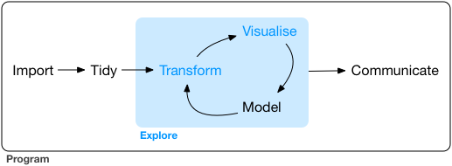
Why start with visualizations?
Getting you “up to speed” with data exploration, the crucial triangle of the workflow, in which “Visualize” is a key part
Visualizations help our understanding but are also a key part in communicating
With charts you can generate leads for in-depth exploration
Sometimes to generate a plot we have to use some transformations, so you will see some transformations as well
Why ggplot2? a very advanced and flexible interface, which is also based on a sound theory “the grammar of graphics”

Slide 4
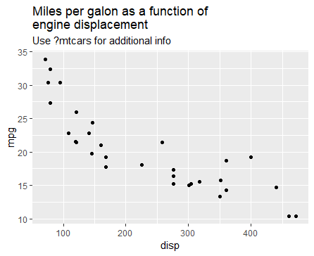
Spot the “aesthetics”
Each ggplot is based on “aesthetics”, the different elements which are data-dependent and are “mapping” data elements into chart elements (like a function). I.e., how the data influences the chart (e.g., fill, color, axis, etc.)
How many “aesthetics” can you spot in the following graph?
What story does this chart tells you?
ggplot(data = mtcars, mapping = aes(x = disp, y = mpg)) + geom_point()
Use the mtcars data.frame
disp (displacement)
should be mapped to x
mpg (miles per galon)
should be mapped to y
Add a layer of points
(scatter plot) which uses the
aforementioned aesthetics
If specified “in order” the “data =” and “mapping =” can be dropped:
ggplot(mtcars, aes(x = disp, y = mpg)) + geom_point()
This is generally true for every function’s arguments

Slide 5
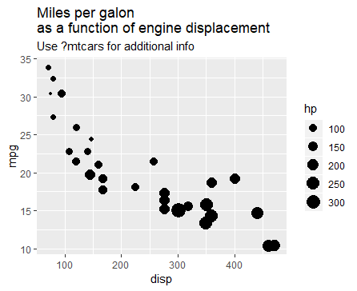
Let’s complicate things Spot the aesthetics (2)
What have I added?
What can you deduce from this chart, that you couldn’t from the previous one?
ggplot(data = mtcars, mapping = aes(x = disp, y = mpg)) +
geom_point(aes(size = hp))

Slide 6
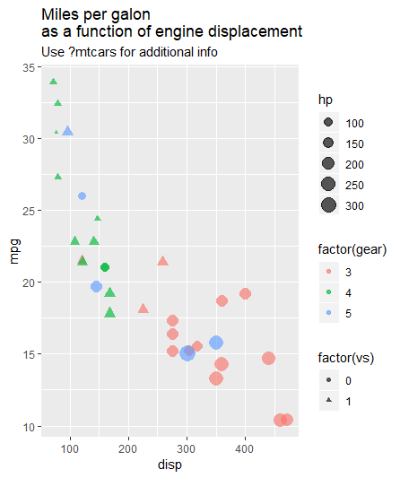
Even further
I added vs: 0=V-shaped engine, 1=strait
What can you deduce from this chart, that you couldn’t from the previous one?

Slide 7
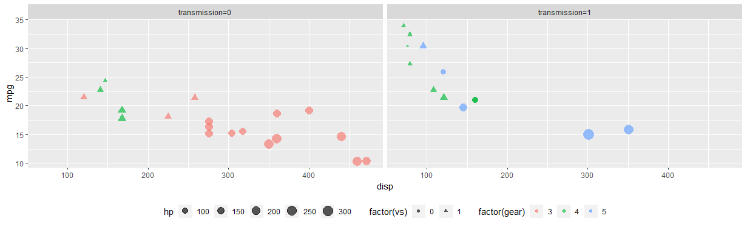
Facets
We can “split” the chart (or look at different levels), using “facets”
For example, split by the transmission type (1 = manual, 0 = automatic)
Try to analyze the graph, what makes cars more efficient (=higher mpg)

Slide 8
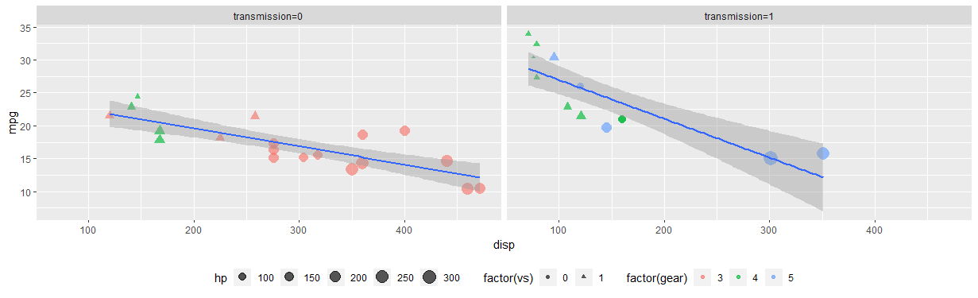
Stats
We can add various “statistics helpers”, such as smoothing (linear regression, lowess, polynoms, etc.)

Slide 9

Warning!
https://dribbble.com/shots/1231599-Data-Monster-2x
Let’s stop here.
ggplot2 has a lot of flexibility, but does that mean we should “push it”?
6 dimensions (mpg, disp, hp, vs, gear, am) means
15 (6 choose 2) 2-vars relationships
20 (6 choose 3) 3-vars relationships….
Not really helpful: our short-term memory can process up to 7±2 “items” (some say even less)
Too complex chart simply get lost in translation, and here comes our true challenge
Match the chart’s complexity to your audience
Generate charts that drive understanding and insights

Slide 10
Back to the “drawing board” Open up the ggplot2 cheat sheet and look at the left side of the first page
A ggplot is comprised of:
Mappings (“aes()”) which control how variables are mapped to properties
Can be global or local
Geoms (geom_*) which control the graphic expression of the mappings
Such as geom_point for scatterplots, geom_line, geom_histogram, geom_boxplot,… there are ~50 different geom_* functions
Additional features include
Stats which add “statistical dressing” to the chart
Such as smoothing, density, ecdf,… there are ~30 different stat_* functions
Coordinates for controlling axis (~10 different coord_* functions)
Facets (splits the graph)
Scale (scale_*_* controls properties of the aesthetics, such as colors, axis labels, etc.)
Theme (theme()) which gives us control on all other elements of the graph

Slide 11
Telling stories with charts
We will have the chance to practice all these elements and technical aspects in exercises, but first, how do you build the “right” chart?
These set of questions will help guide you:
How many variables are involved?
What are the properties of each variable?
Continuous (numeric) / Discrete (factor) / Ordinal (ordered factor) / Date / Logical
Consider what are appropriate mappings
By axis / color / shape / fill / size / other
Fine tuning: titles, axis titles, size, legend
Are you missing important data?
Are you creating any distortions due to axis or scales?

Slide 12
tidyverse prerequisites
Throughout the exercise you might also have the chance to use the following tidyverse (dplyr) functions:
mutate() – create a new variable
glimpse() – show the first few values of each vector
filter() – filter the data according to a specific condition
count() – count the number of observations per each combination
group_by() – group the dataset by a specific set of variables
summarise() – conduct summarizing operations (like mean or sum) according to the dataset’s grouping
%>% pipe operator
Lets demonstrate these over a live R session, via the mtcars dataset.

Slide 13
Exercise
From the exercise folder open 02-Plotting.Rmd and start
“Exercise 1: the google play dataset”
Before starting, if you want a stable copy of your work, it is recommended you save it in a separate location (to not run it over when you git pull in the future)
After we solve the exercise together (or if you finished early on), continue to exercise 1.5 (related)

Slide 14
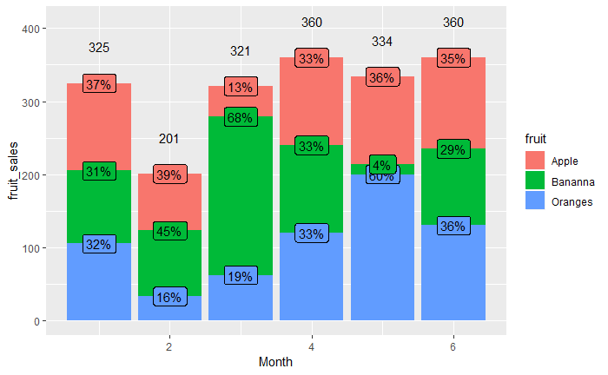
Mini exercise – how would you…(1)?
Use the ggplot2 cheat sheet
Answer in groups of 2-3
What are the three geoms required to produce this chart?
What are the aesthetic mappings?
4 minutes

Slide 15
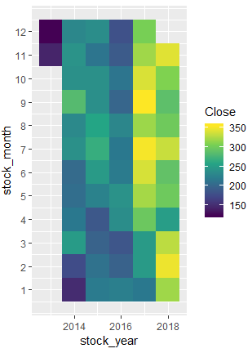
Mini exercise – how would you…(2)?
TSLA (Tesla) stock closing price
Use the ggplot2 cheat sheet
Answer in groups of 2-3
What is the one geom required to produce this chart?
What are the aesthetic mappings?
4 minutes

Slide 16
Exercise
In 02-Plotting.Rmd, continue to exercise 2.
In 02-Plotting.Rmd, continue to exercise 3.
In 02-Plotting.Rmd, continue to exercise 4.

